Slide 1

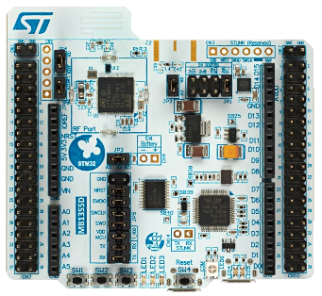
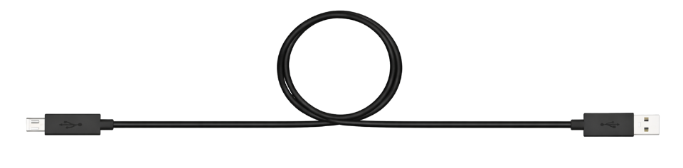
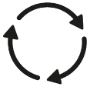
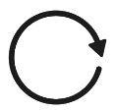
STM32 (C)
PC (Python)
UART (Low Power)
Request Data (N)
No Data
No REQ
Request
Data (N)
Wait for REQ
1
Data arrives
Send ACK
Send
results
Acknowledgement (N)
REQ arrives
Send DATA
ACK arrives
or Timeout
Train
Wait for
ACK
Results (N)
No ACK
Request Data (N+1)

